Slide 1
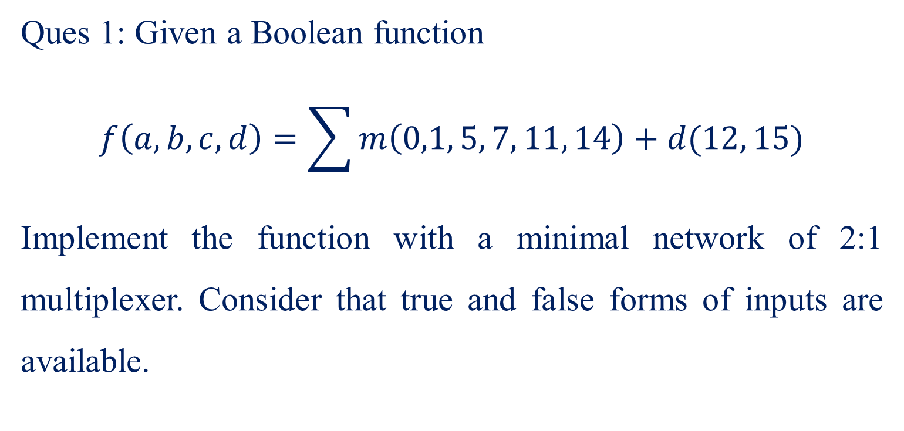
Ques 1: Given a Boolean function
$$f\left(a,b,c,d\right)=\sum{m\left(0,1, 5, 7, 11, 14\right)+d(12, 15)}$$
Implement the function with a minimal network of 2:1 multiplexer. Consider that true and false forms of inputs are available.

Slide 2





$$f\left(a,b,c,d\right)=\sum{m\left(0,1, 5, 7, 11, 14\right)+d(12, 15)}$$
cd
00 01 11 10
ab
00
01
11
10
1 | 1 | 0 | 0
0 | 1 | 1 | 0
X | 0 | X | 1
0 | 0 | 1 | 0
$$\overline{a}\overline{b}\overline{c}$$
$$\overline{a}bd$$
$$ab\overline{d}$$
$$acd$$
$$f(a,b,c,d)=\overline{a}\overline{b}\overline{c}+\overline{a}bd+ab\overline{d}+acd$$

Slide 3

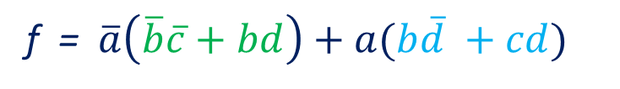




$$f=\overline{a}\overline{b}\overline{c}+\overline{a}bd+ab\overline{d}+acd$$
$$\overline{c}$$
0
1
f = $\overline{a}\left(\overline{b}\overline{c}+bd\right)+a(b\overline{d} +cd)$
2:1
MUX
Y
d
$$s_{0}$$
0
1
b
2:1
MUX
Y
f
b
$$s_{0}$$
0
1
2:1
MUX
Y
a
c
$$s_{0}$$
d

Slide 4
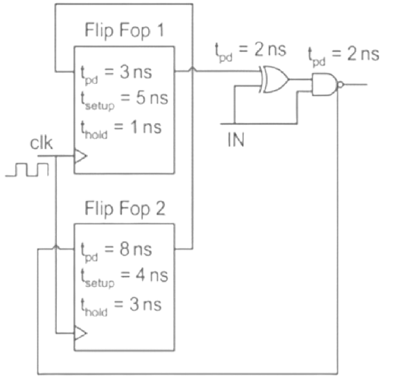
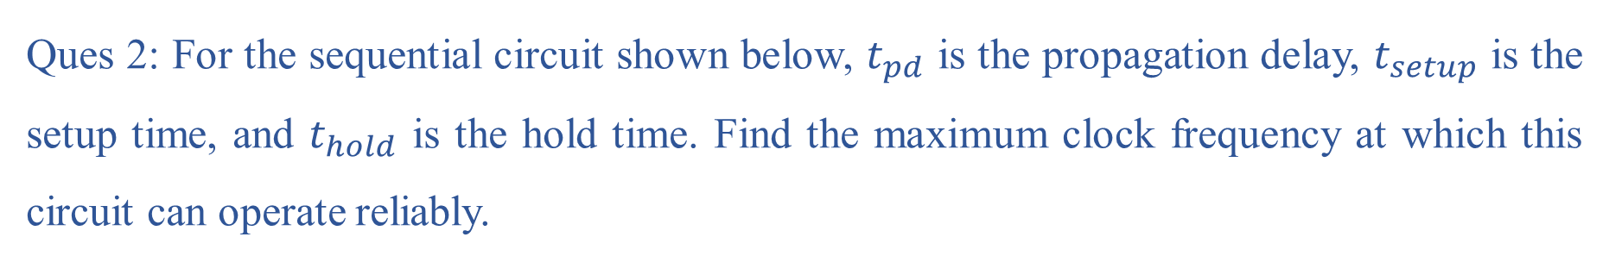
Ques 2: For the sequential circuit shown below, $t_{pd}$ is the propagation delay, $t_{setup}$ is the setup time, and $t_{hold}$ is the hold time. Find the maximum clock frequency at which this circuit can operate reliably.

Slide 5
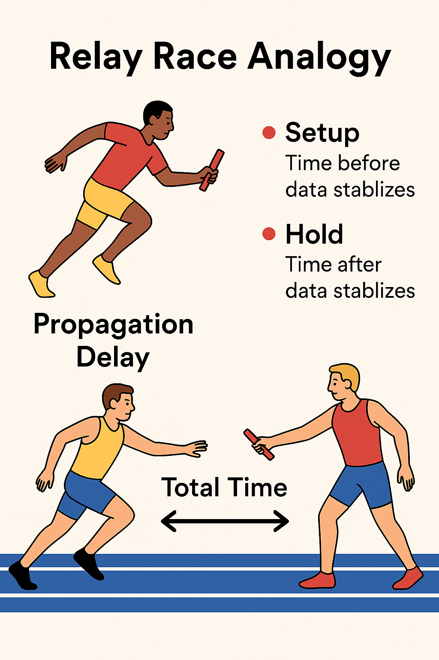
Imagine a Race with Baton Passing
Think of this problem like a relay race where runners pass a baton (data) from one runner (flip-flop) to another.
Each runner needs some time to reach the next runner → this is the propagation delay.
The next runner must be ready and standing properly to receive the baton → this is the setup time.
After receiving the baton, the next runner must hold it securely for a little while before starting to run → this is the hold time.
If these rules aren’t followed:
The baton might be dropped → this is like incorrect data.
The next runner might not be ready → the system fails.

Slide 6
Term | What it means in the relay race analogy
Propagation delay (tₚd) | Time the runner takes to reach the next runner with the baton.
Setup time (tₛₑₜᵤₚ) | Time before the baton is passed where the next runner must be ready and stable.
Hold time (tₕₒₗd) | Time after receiving the baton where the next runner must hold it safely before running.

Slide 7
The Sequential Circuit – How It Works
Imagine:
Flip-Flop 1 is the first runner.
Flip-Flop 2 is the second runner.
The baton travels through some hurdles (logic gates), which slow it down — these are the propagation delays of logic gates.
The clock is like the whistle that tells runners when to start running.
If the baton reaches the next runner too fast or too slow, the race will be disqualified → this is why we must calculate the maximum clock frequency so everything runs smoothly.

Slide 8
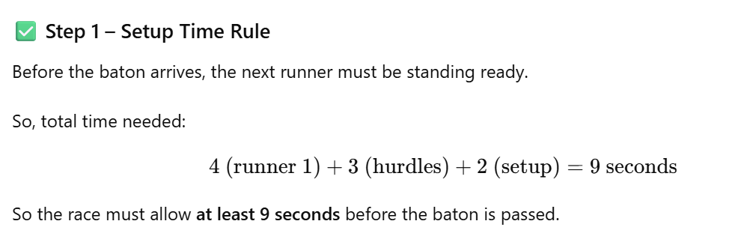
In a race between two runners, the baton passing rules are:
Runner 1 takes 4 seconds to reach the next runner.
The hurdles between them add 3 seconds of delay.
The next runner must be ready 2 seconds before receiving the baton.
After receiving the baton, the next runner must hold it for at least 1 second before running.
Find the minimum total time the race must allow for the baton to be safely passed without errors.

Slide 9
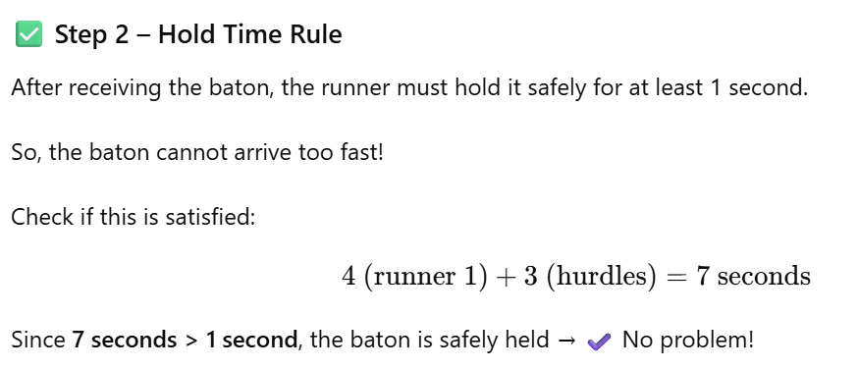
Relating Back to Electronics
The baton = data.
The runners = flip-flops.
The hurdles = logic gates.
The clock = timing signal telling when to pass data.
If timing is wrong → the circuit fails!

Slide 10
✔ A sequential circuit is like a relay race where data is passed from one flip-flop to another.
✔ The baton (data) takes time to travel — this is propagation delay.
✔ The next runner must be ready before the baton arrives — this is setup time.
✔ After receiving the baton, it must be held securely before the next move — this is hold time.
✔ The clock determines when the baton is passed. It must be slow enough to meet setup requirements but not too fast to violate hold time.
✔ These rules ensure that digital circuits work reliably without errors.

Slide 11
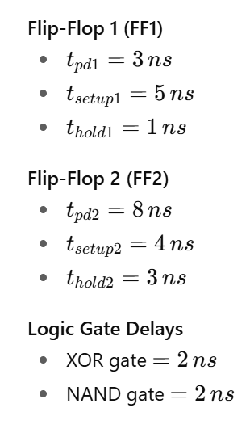
Ques 2: For the sequential circuit shown below, $t_{pd}$ is the propagation delay, $t_{setup}$ is the setup time, and $t_{hold}$ is the hold time. Find the maximum clock frequency at which this circuit can operate reliably.

Slide 12
🔑 1. Propagation Delay (tₚd)
This is like the time it takes for data to travel from one point to another after a signal is applied.
Analogy: You send a message to a friend, but it takes a few seconds to reach them — that's propagation delay.
🔑 2. Setup Time (tₛₑₜᵤₚ)
Before a clock pulse comes, data must already be stable and ready.
Analogy: If you're about to catch a ball, you need to have your hands in position before the ball arrives.
🔑 3. Hold Time (tₕₒₗd)
After the clock pulse comes, the data must stay stable for a little while so the flip-flop can correctly latch it.
Analogy: After catching the ball, you need to hold it for a short time before throwing it again.

Slide 13
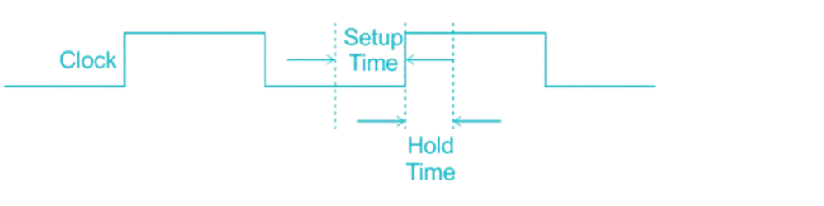
Setup Time: It is the amount of time for which the data at the synchronous input must be stable before the active edge of the clock.
Hold Time: It is the amount of time for which the data of the synchronous input must be stable after the active edge of the clock.

Slide 14
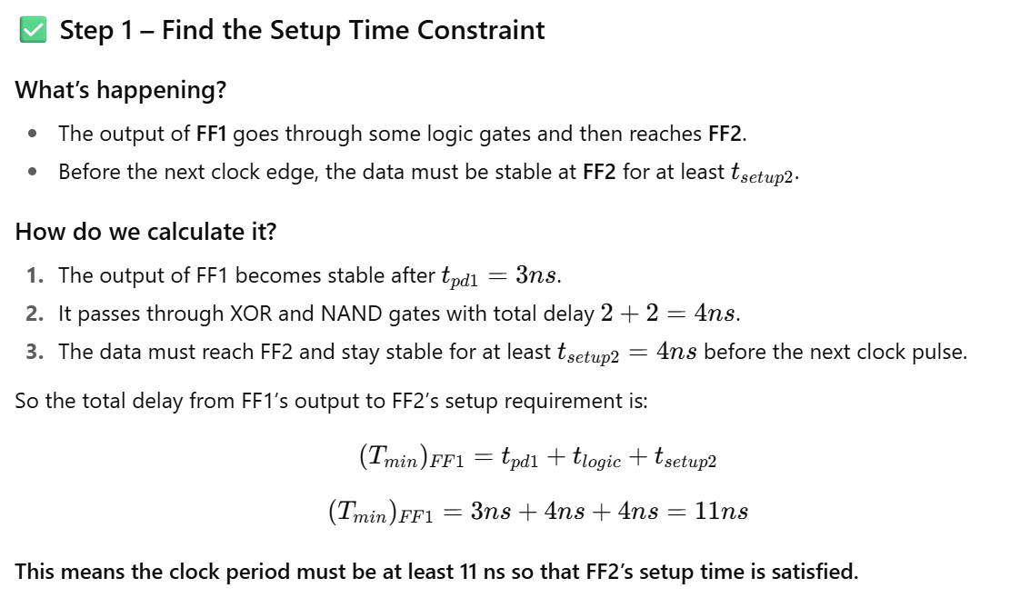

Slide 15
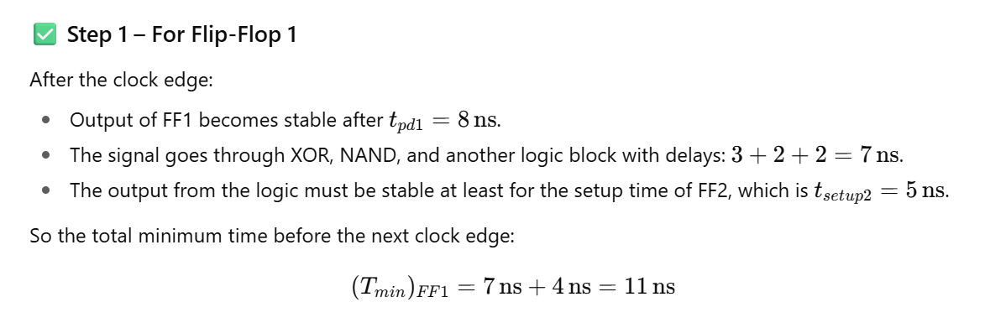
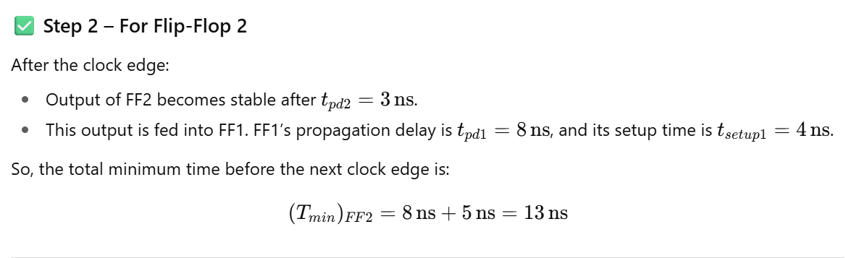

Slide 16
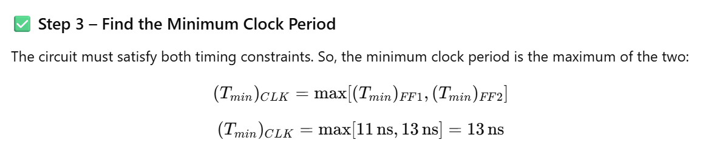
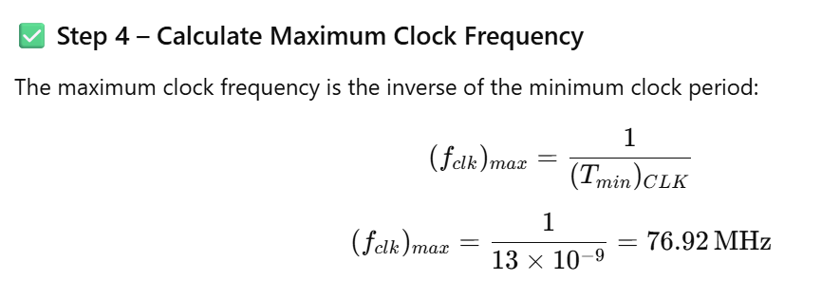
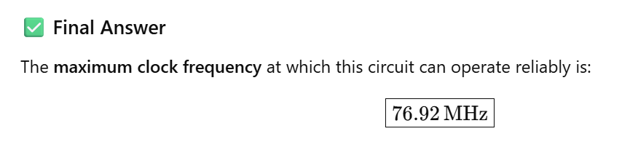

Slide 17
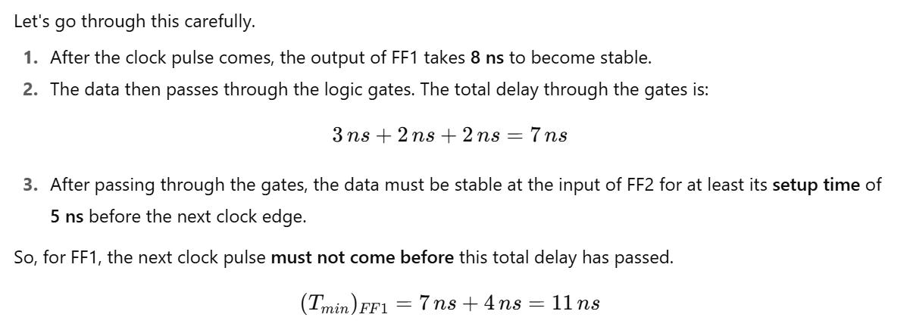

Slide 18
Maximum clock frequency = The minimum time after which the next clock edge arrives
For Flip-Flop 1:
After the arrival of a clock edge, the output becomes stable after t_{pd} = 8 ns.
The output is then passed through on XOR gate and a NAND gate.
The net delay will be: 3ns + 2ns + 2ns = 7ns
This output from the NAND gate after 7 nsec must remain stable for at least t_{setup} time of FF2
So, the minimum time after which the next clock edge should arrive at FF 1 is
(T_{min})_{FF1} = 7 ns +4ns = 11 ns

Slide 19
For Flip-Flop 2:
After the arrival of a clock edge, the output becomes stable after t_{pd} = 3 ns.
The output of FF2 is the input to FF1, this output after tpd = 8 ns must remain stable for at least (t_{setup}) time of FF1, i.e.. for 5 ns, before the next clock edge should arrive at FF1.
The minimum time after which the next clock should arrive at FF1 should be:
(T_{min})_{FF2} = 8 ns + 5ns = 13 ns

Slide 20
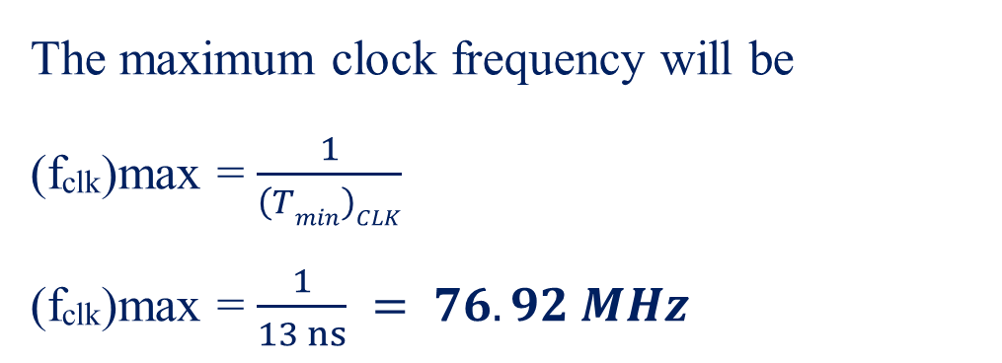
For the given circuit to operate reliably, the minimum clock time
(T_{min})_{CLK} = max[(T_{min})_{FF1} , (T_{min})_{FF2}] = 13 ns
The maximum clock frequency will be
(f_{clk})max = $\frac{1}{\left(Tmin\right)CLK}$
(f_{clk})max = $\frac{1}{13 ns} = 76.92 MHz$

Slide 21
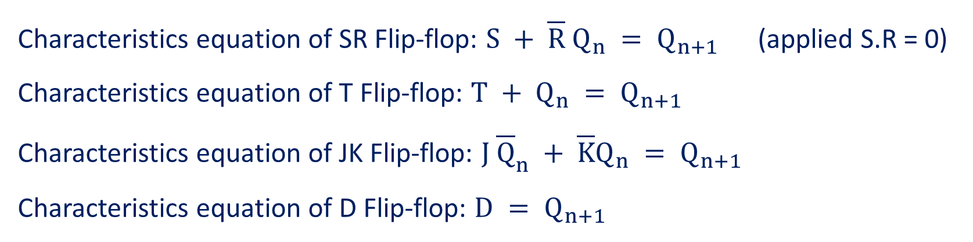
Ques 4: Transform the S-R flip flop to
  T flip flop
  J-K flip flop
  D flip flop
Characteristics equation of SR Flip-flop: $S + \overline{R} Q_{n} = Q_{n+1}$ (applied S.R = 0)
Characteristics equation of T Flip-flop: $T + Q_{n} = Q_{n+1}$
Characteristics equation of JK Flip-flop: $J{ \overline{Q}}_{n} + \overline{K}Q_{n} = Q_{n+1}$
Characteristics equation of D Flip-flop: ${D = Q}_{n+1}$

Slide 22
1. What is a Flip-Flop?
A flip-flop is a basic building block in digital electronics. It’s a circuit that stores one bit of information – meaning it holds either a 0 or a 1.
You can think of a flip-flop as a small memory cell, similar to how you might turn a light switch on or off and it stays in that position until you change it again. A flip-flop holds its state until it is told to change.
Real-world analogy:
Imagine a bucket:
If you put water in it → it’s full → that’s like storing 1.
If you empty it → it’s empty → that’s like storing 0.
The flip-flop “remembers” whether it was full or empty.

Slide 23
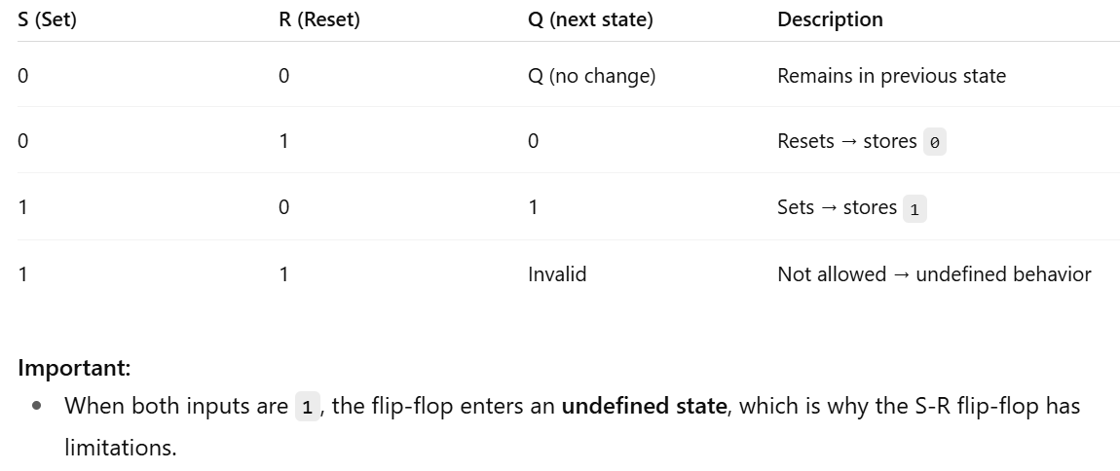
What is an S-R Flip-Flop?
The Set-Reset (S-R) flip-flop is one of the simplest types of flip-flops.
It has:
Two inputs:
  S (Set): Tells the flip-flop to store a 1.
  R (Reset): Tells the flip-flop to store a 0.
Two outputs:
  Q: The current state (either 0 or 1).
  Q̅ (Q-bar): The opposite of Q.

Slide 24

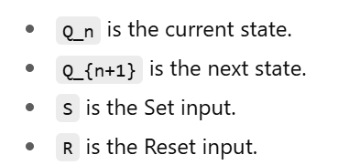
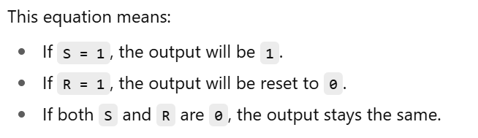
3. What is a Characteristic Equation?
The characteristic equation is a mathematical way to express how the flip-flop's output changes based on its inputs.
For the S-R flip-flop, the equation is:

Slide 25
Why Transform the S-R Flip-Flop?
Although simple, the S-R flip-flop has problems:
Both inputs being 1 causes an invalid state.
It’s not suitable for many applications.
So, engineers use other types of flip-flops that are easier to control and avoid undefined behavior. These include:
T flip-flop (Toggle)
J-K flip-flop
D flip-flop (Data or Delay)
But instead of designing them from scratch, we can modify the S-R flip-flop by carefully defining how its inputs are connected.

Slide 26
Transforming S-R to T Flip-Flop
What is a T flip-flop?
T (Toggle) flip-flop changes its state when T = 1.
If T = 0, it stays in the same state.
Real-world analogy:
A T flip-flop like a light switch:
If you press it → it changes from ON to OFF or OFF to ON → toggles.
If you don’t press it → stays the same.

Slide 27
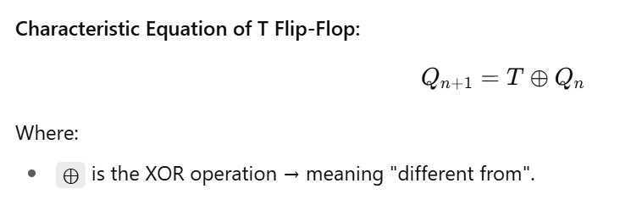
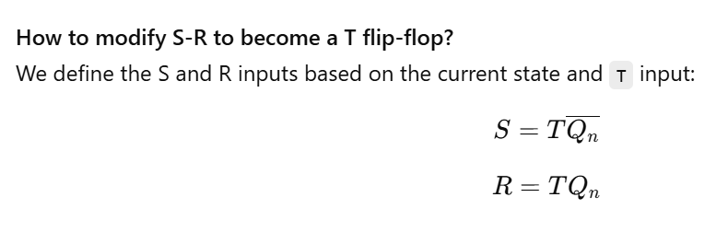

Slide 28
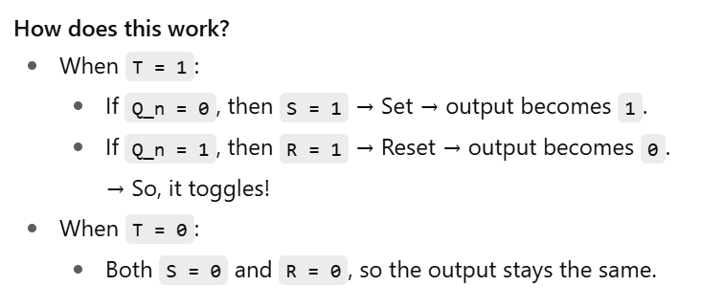

Slide 29
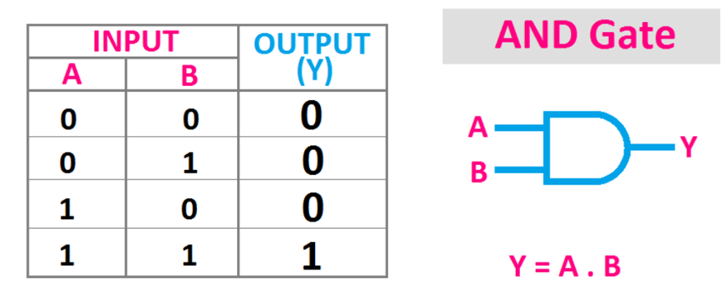
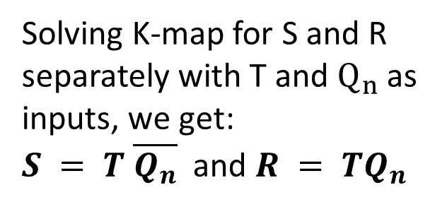

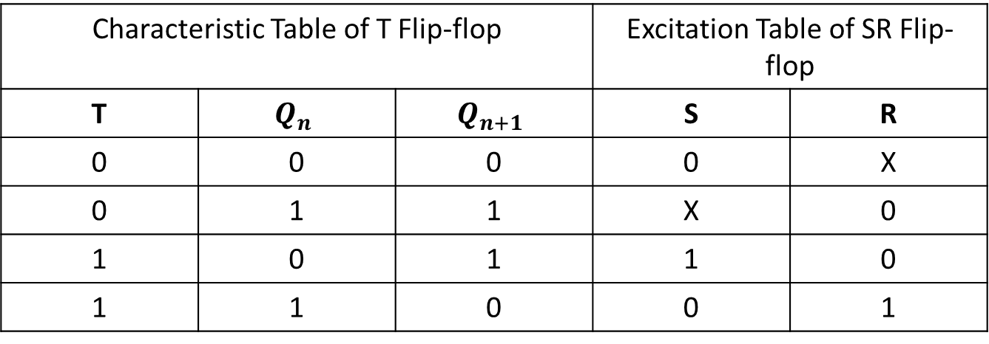



Transforming SR Flip-flop to T Flip-flop
Characteristic Table of T Flip-flop |  |  | Excitation Table of SR Flip-flop
T | $$Q_{n}$$ | $$Q_{n+1}$$ | S | R
0 | 0 | 0 | 0 | X
0 | 1 | 1 | X | 0
1 | 0 | 1 | 1 | 0
1 | 1 | 0 | 0 | 1
Solving K-map for S and R separately with T and $Q_{n}$ as inputs, we get:
$S = T \overline{Q_{n}}$ and $R = TQ_{n}$
S
$$Q_{n}$$
$$T$$
$$CLK$$
R
$$\overline{Q_{n}}$$

Slide 30
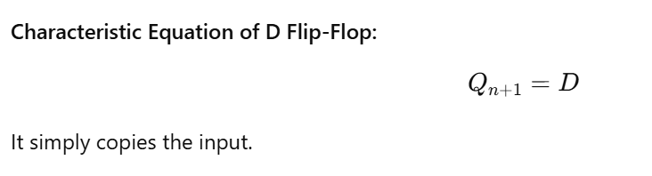
Transforming S-R to D Flip-Flop
What is a D flip-flop?
The D (Data or Delay) flip-flop stores the value of the input D directly into Q.
It’s simple and used in memory elements like registers.
Real-world analogy:
You press a button, and the state is stored as it is → no calculations needed.

Slide 31
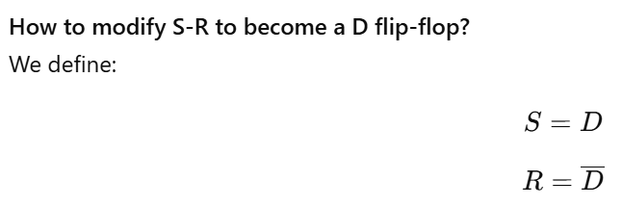
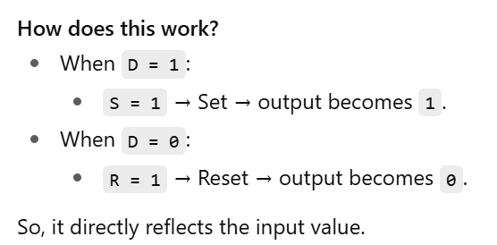

Slide 32
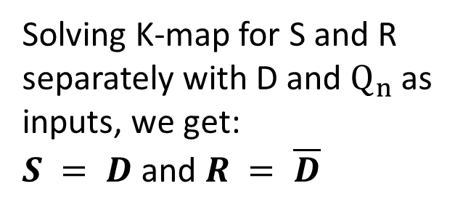
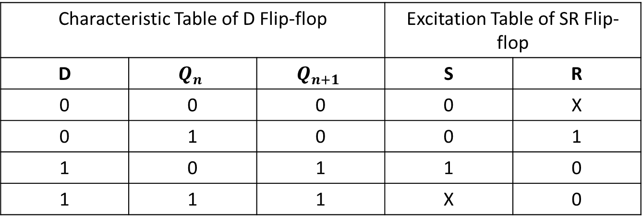

Transforming SR Flip-flop to D Flip-flop
Characteristic Table of D Flip-flop |  |  | Excitation Table of SR Flip-flop
D | $$Q_{n}$$ | $$Q_{n+1}$$ | S | R
0 | 0 | 0 | 0 | X
0 | 1 | 0 | 0 | 1
1 | 0 | 1 | 1 | 0
1 | 1 | 1 | X | 0
Solving K-map for S and R separately with D and $Q_{n}$ as inputs, we get:
$S = D$ and $R = \overline{D}$
S
$$Q_{n}$$
$$D$$
$$CLK$$
R
$$\overline{Q_{n}}$$

Slide 33
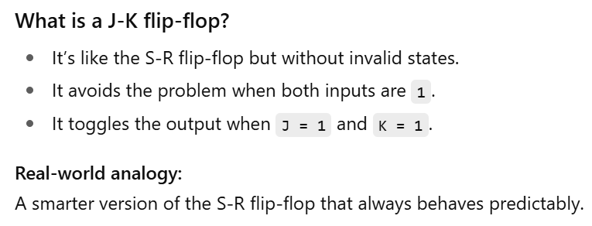
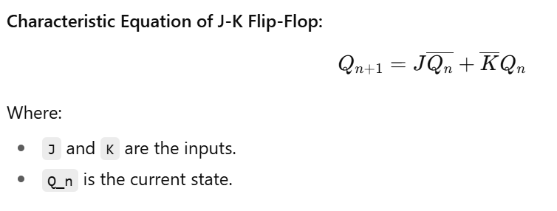
Transforming S-R to J-K Flip-Flop

Slide 34
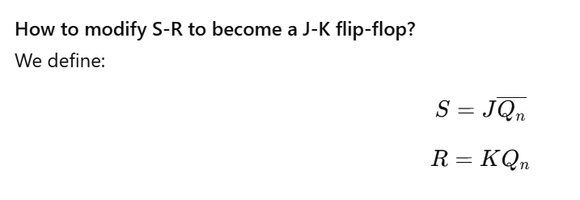
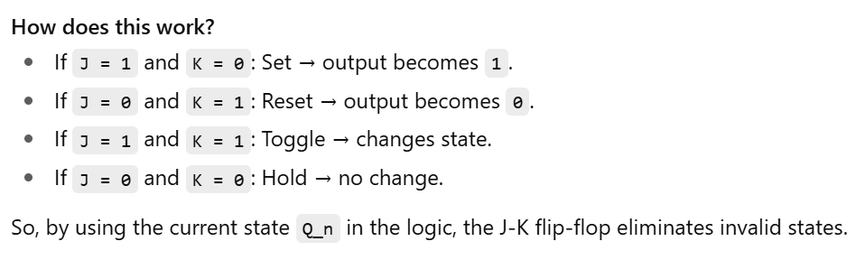

Slide 35
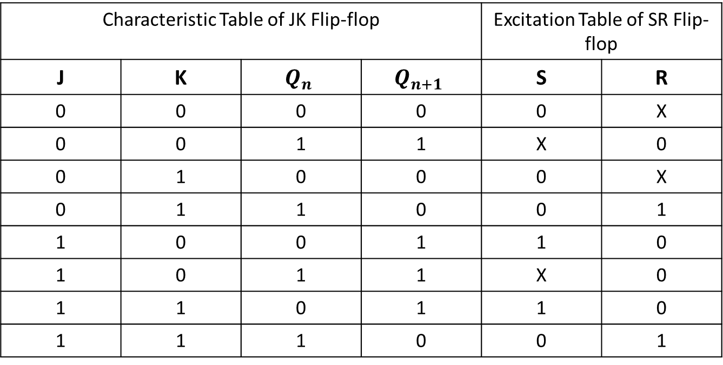
Transforming SR Flip-flop to JK Flip-flop
Characteristic Table of JK Flip-flop |  |  |  | Excitation Table of SR Flip-flop
J | K | $$Q_{n}$$ | $$Q_{n+1}$$ | S | R
0 | 0 | 0 | 0 | 0 | X
0 | 0 | 1 | 1 | X | 0
0 | 1 | 0 | 0 | 0 | X
0 | 1 | 1 | 0 | 0 | 1
1 | 0 | 0 | 1 | 1 | 0
1 | 0 | 1 | 1 | X | 0
1 | 1 | 0 | 1 | 1 | 0
1 | 1 | 1 | 0 | 0 | 1

Slide 36

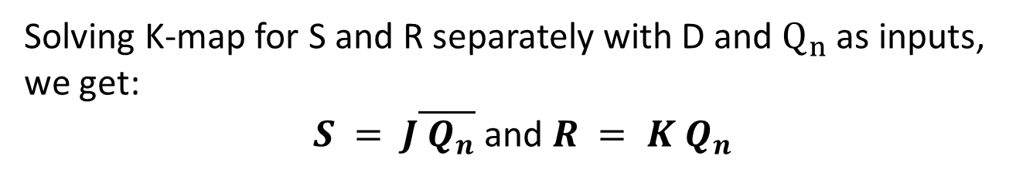


Solving K-map for S and R separately with D and $Q_{n}$ as inputs, we get:
$S = J\overline{{ Q}_{n}}$ and $R = K Q_{n}$
J
S
$$Q_{n}$$
$$CLK$$
K
R
$$\overline{Q_{n}}$$

Slide 37
Final Thoughts
✔ Flip-flops are essential for memory and state retention in digital circuits.
✔ The S-R flip-flop is the foundation but has limitations due to undefined states.
✔ By adjusting how the inputs S and R are connected, you can create more advanced flip-flops:
T flip-flop toggles based on its state.
J-K flip-flop eliminates invalid states and allows toggling when both inputs are active.
D flip-flop simply stores data reliably.
✔ Understanding these transformations is key for designing more complex digital systems like counters, registers, and processors.

